Slide 1

ECE477 Midterm Design Review: Team 3
<Add team picture or relevant project picture here>

Slide 2
Outline
Project Overview
Major Components
Block Diagram
Packaging Design
Electrical Schematic
PCB Layout
Prototyping Progress
Software Development Status
Project Timeline
Questions

Slide 3
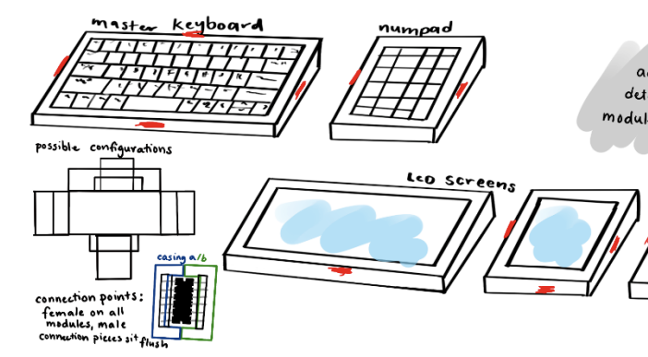
Project Overview
Not your average Keyboard (NYAKB)
NYAKB is a newcomer in the growing mechanical keyboard community that includes a high quality, phone sized LCD screen that will display various information, and can interact with the keyboard itself. The module will be detachable. Current keyboards on the market don't have the unique display functionality NYAKB has.

Slide 4
PSSCs
PSSC #1 (Hardware): An ability to have a key switch matrix for the various typing keys on a keyboard that can be scanned and debounced for clean inputs by the microcontroller on the main keyboard module.
PSSC #2 (Hardware): An ability to drive an LCD display via SPI.
PSSC #3 (Hardware): An ability to step down 5V USB input power to 3.3V for the main keyboard MCU and display module MCU/display.
PSSC #4 (Hardware): An ability to have the main keyboard MCU serve as master and communicate to submodule MCU as slave over I2C.
PSSC #5 (Hardware): An ability to communicate key presses from the user to the Host PC over a USB connection.

Slide 5
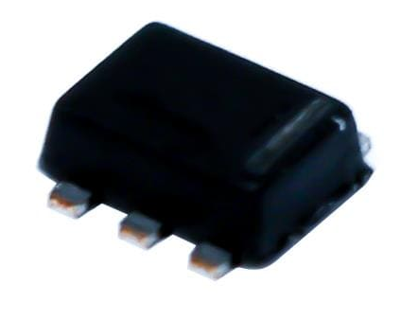
Major Components
Power Regulation
Buck Converter: TPS563231DRLT
Specs:
Input range 4.5V-17V
Output 3.3V
Max Current 3A
Usage:
This will be used to step down USB 5V input to 3.3V that will power the main keyboard (stm32f4) as well as submodules via the hot plug connection

Slide 6
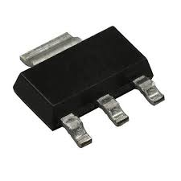
Major Components
Power Regulation
Voltage Regulator: LD1117S33TR_SOT223
Specs:
Input (Max) 15V
Output (Min/Fixed) 3.3V
Dropout 1.2V @ 800mA
Usage:
Built into the decoupling capacitor to step down the 5V input from the programming header on the sub-module device to 3.3V

Slide 7
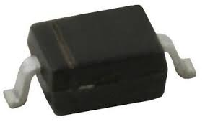
Major Components
Power Regulation
Voltage Regulator: BAT60JFILM
Specs:
Schottky Diode
DC Reverse Vr (Max) 10V
Forward Vf (Max) 580mV @ 1A
Usage:
Drop 3.3V to 3V0 for the SPI LCD display

Slide 8
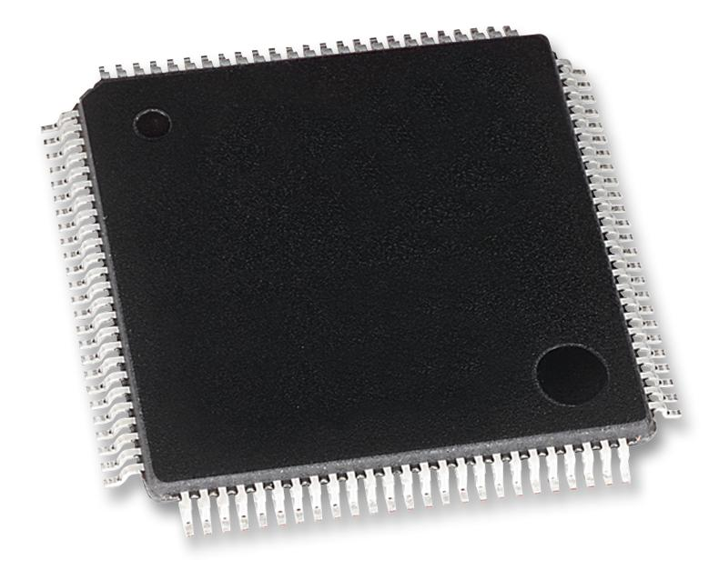
Major Components
Microcontrollers
Main Keyboard MCU: STM32F407VGT6
Specs:
USB FS Controller
I2C hardware blocks
GPIO
Usage:
This MCU will be used to communicate with the host PC over USB and to submodules over I2C. It will also scan the key matrix using GPIO
Power Consumption:
Max: 240mA @ 3.3V

Slide 9
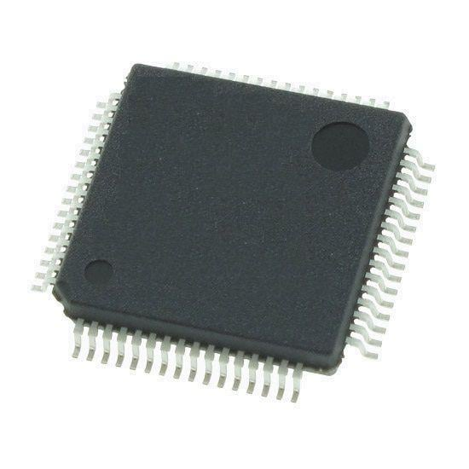
Major Components
Microcontrollers
sub-module MCU: STM32F091RCT6
Specs:
I2C hardware blocks
SPI hardware blocks
Usage:
This MCU will be used to communicate with the SPI TFT LCD display to render info and to the main keyboard over I2C over the hot plug connector.
Power Consumption:
Max: 120mA @ 3.3V

Slide 10
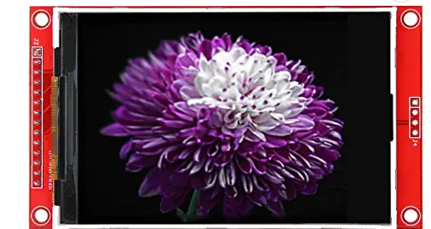
Major Components
Display
Display: MSP3520
Specs:
3.5" TFT display module
320x480px resolution
Usage:
Controlled over SPI
Present visual information to user
Power Consumption:
Approx. 84mA @ 3.0V

Slide 11
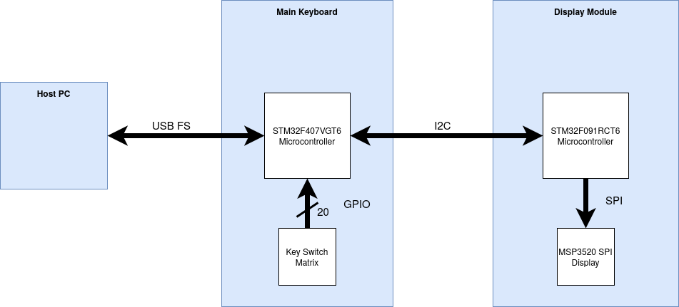
Block Diagram

Slide 12
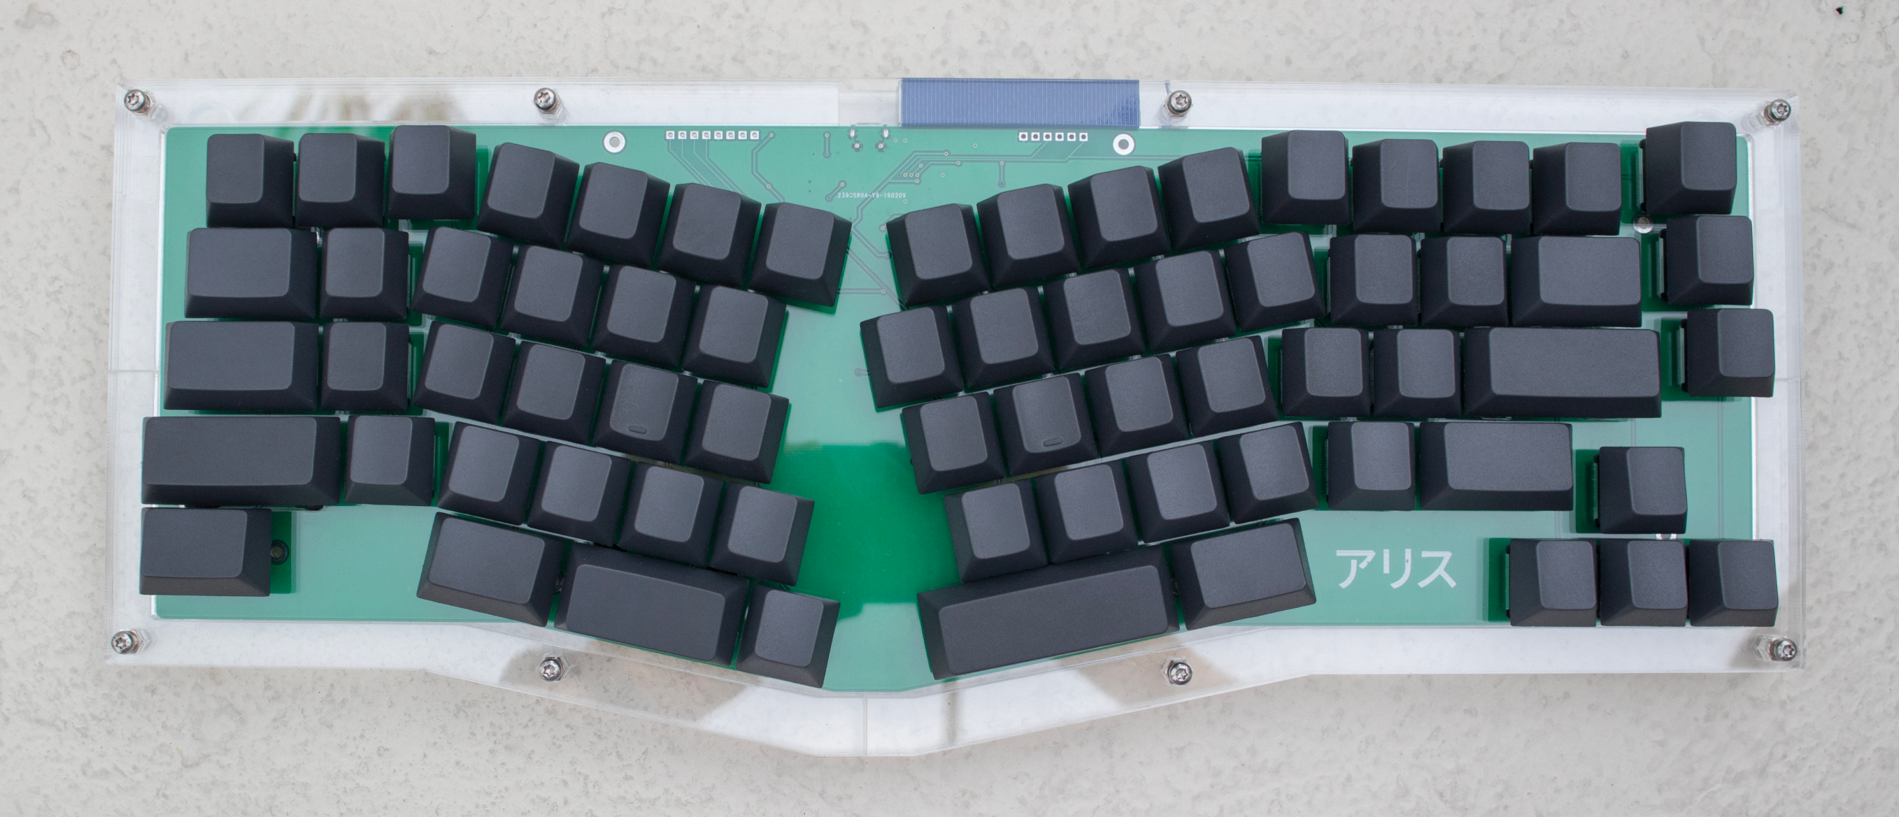
Packaging Design
Changes to our Packaging
We've opted for a new layout, so we've changed our packaging plans as well.
We'll be sandwiching the PCB between laser cut acrylic plates, and mounting them with screws.
Dimensions:
365mm x 142mm

Slide 13
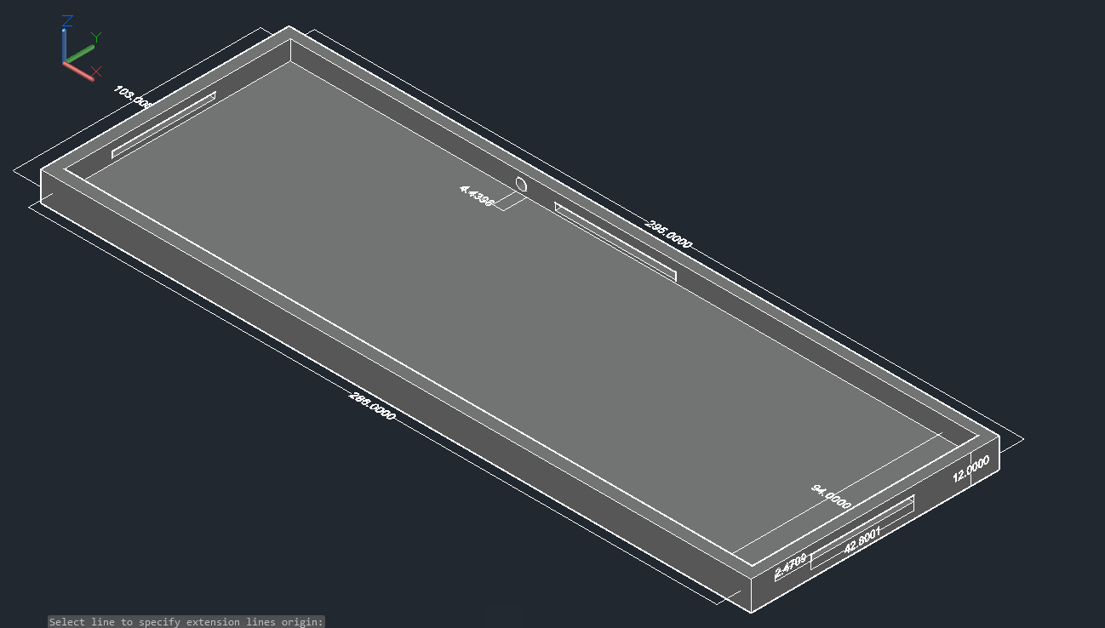
Packaging Design
Main Keyboard Original Design
Outer layer 295x103x12 mm
Inner layer 286x94x8 mm
3 access points to allow it to connect to other modules, and a point of access to connect to the USB port.
We will be using acrylic to create the packaging
Keyboard design has evolved

Slide 14
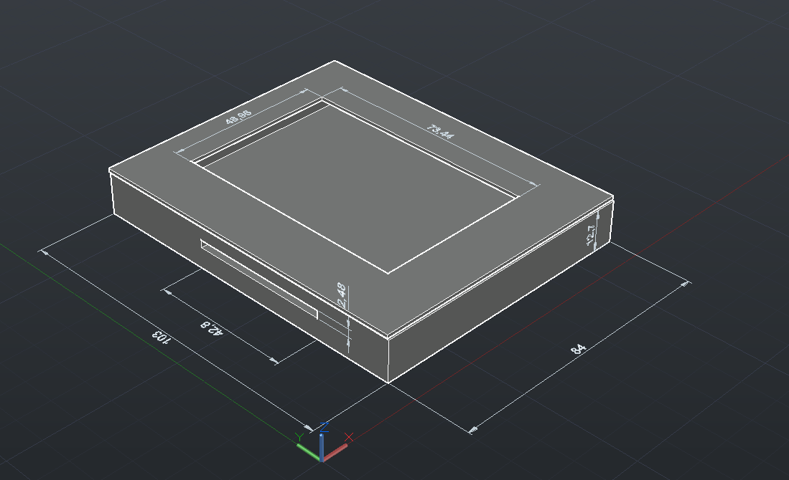
Packaging Design
sub-module Original Design
Outer layer 83x103x12 mm
Inner layer 72x94x8 mm
Access point located on the left side of the device
Opening left for the LCD display to be seen
Plan to match materials with main keyboard by using the same acrylic
Keyboard design has evolved

Slide 15
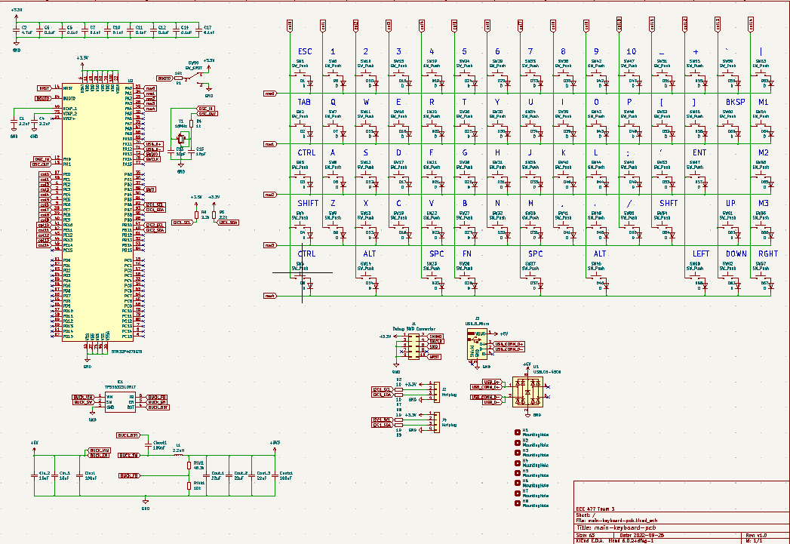
Electrical Schematic
Main Keyboard Overview

Slide 16
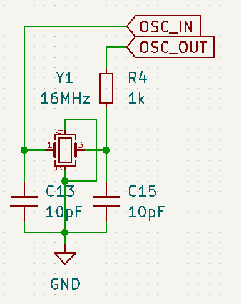
Electrical Schematic
Main Keyboard Crystal Oscillator

Slide 17
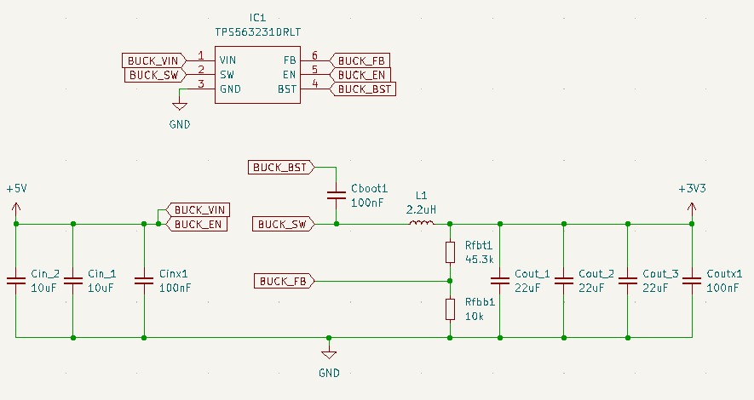
Electrical Schematic
Main Keyboard Buck Converter

Slide 18
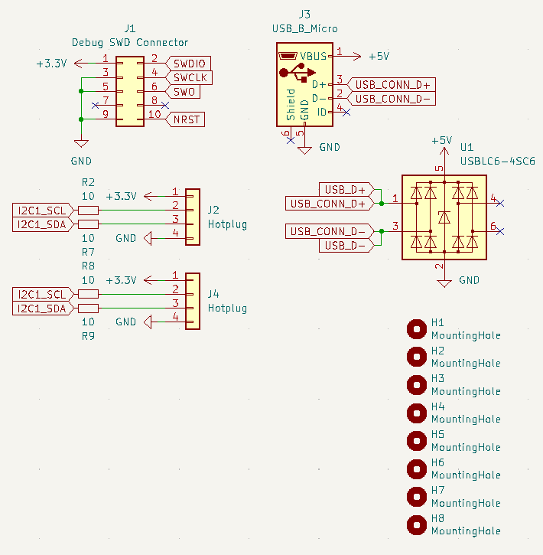
Electrical Schematic
Main Keyboard Connectors

Slide 19
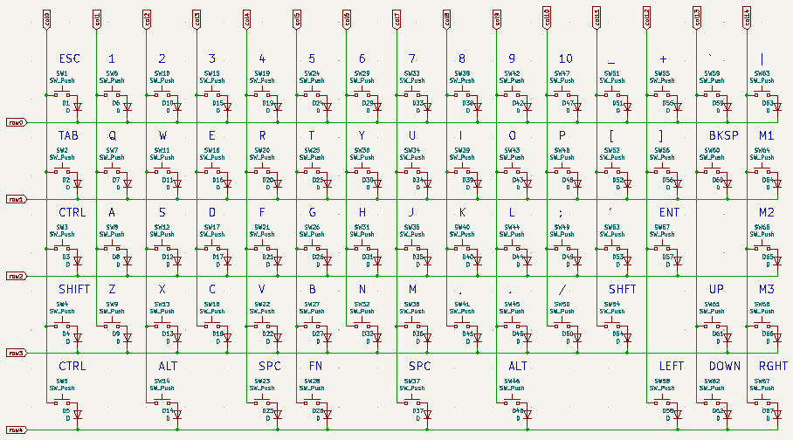
Electrical Schematic
Main Keyboard KeySwitch Matrix

Slide 20
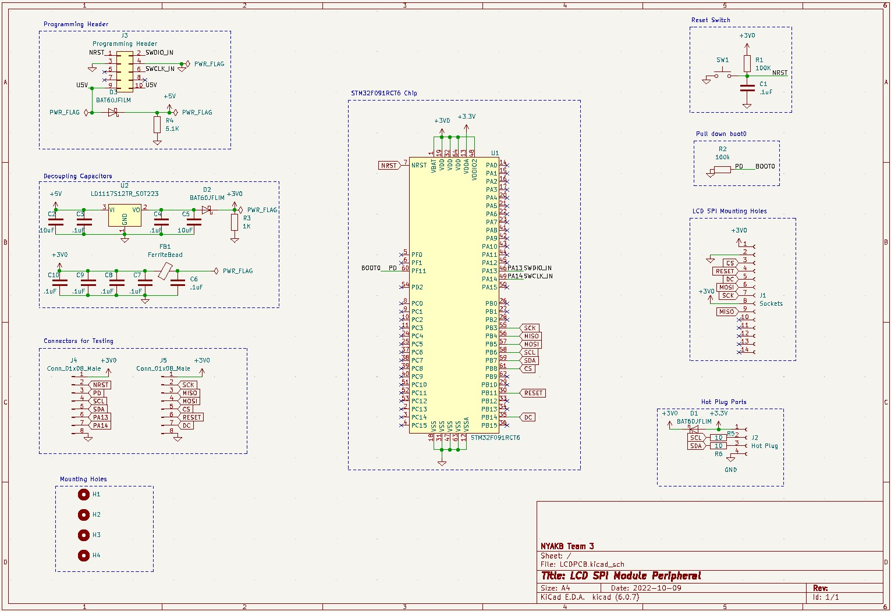
Electrical Schematic
sub-module overview

Slide 21
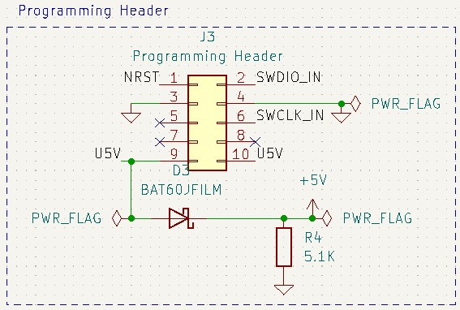
Electrical Schematic
sub-module programming header

Slide 22
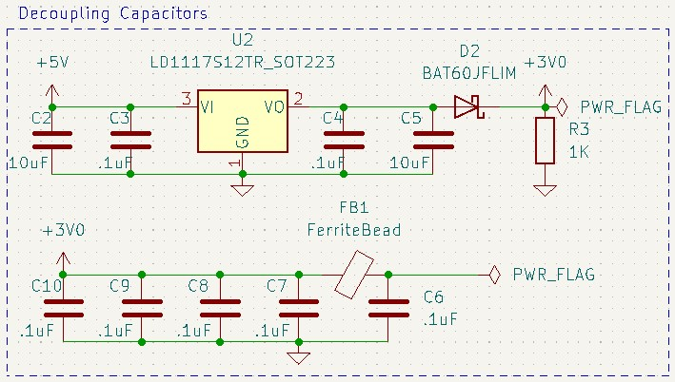
Electrical Schematic
sub-module Decoupling capacitors

Slide 23
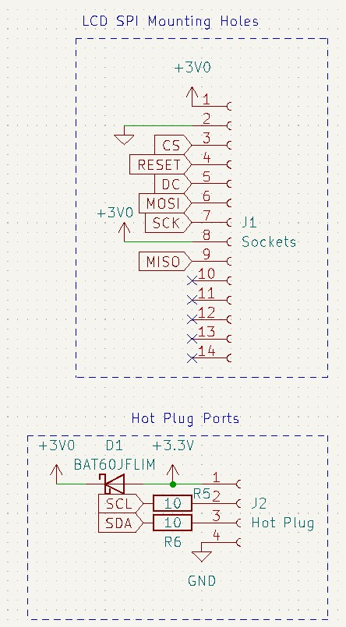
Electrical Schematic
sub-module Connectors

Slide 24
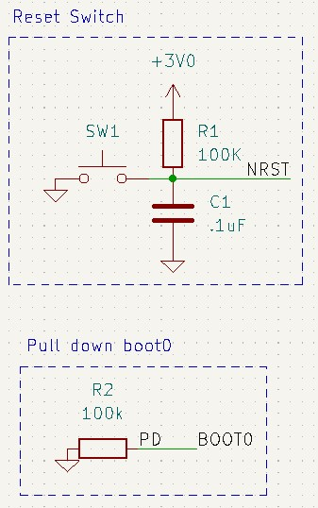
Electrical Schematic
sub-module Reset and Pull down

Slide 25
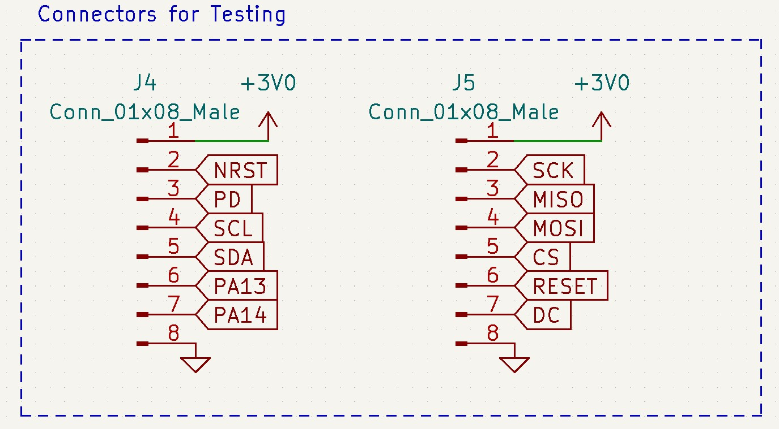
Electrical Schematic
sub-module Testing

Slide 26
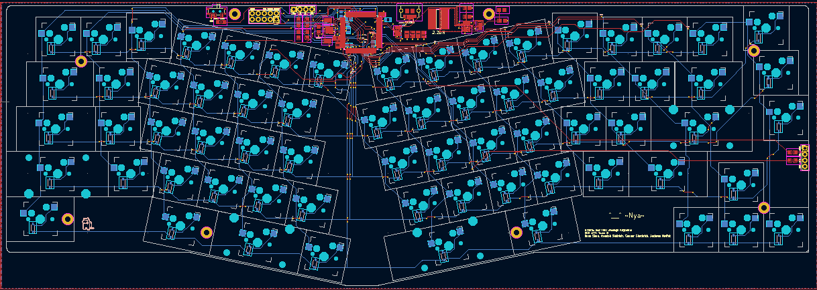
PCB Layout
Main Keyboard Overview

Slide 27
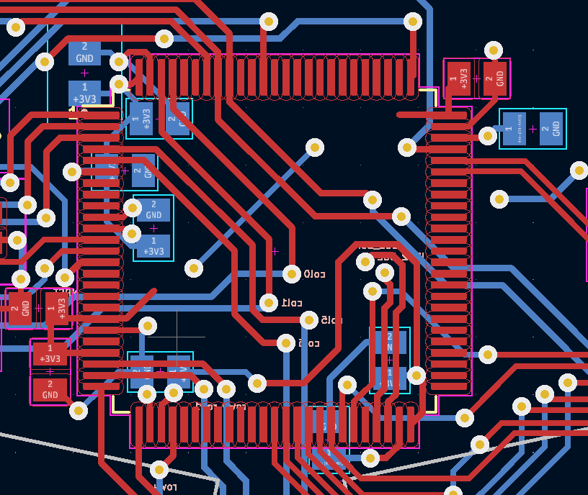
PCB Layout
Main Keyboard Microcontroller

Slide 28
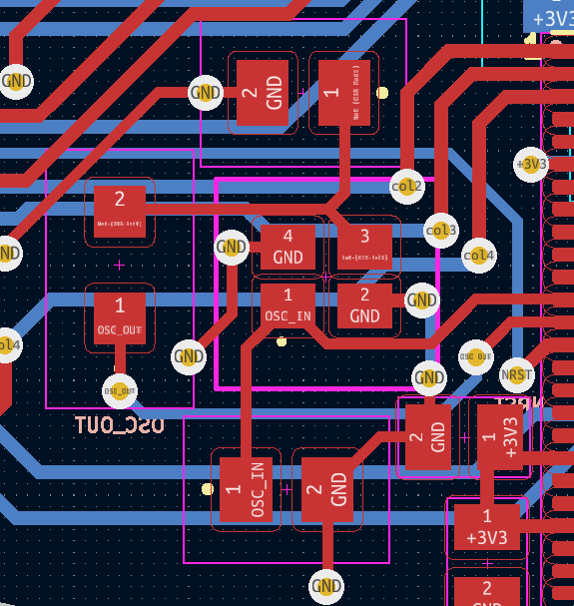
PCB Layout
Main Keyboard Crystal Oscillator

Slide 29
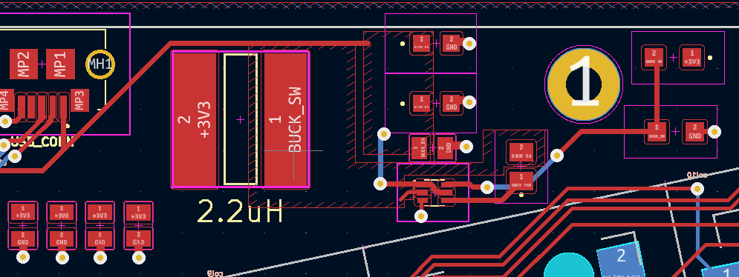
PCB Layout
Main Keyboard Buck Converter

Slide 30
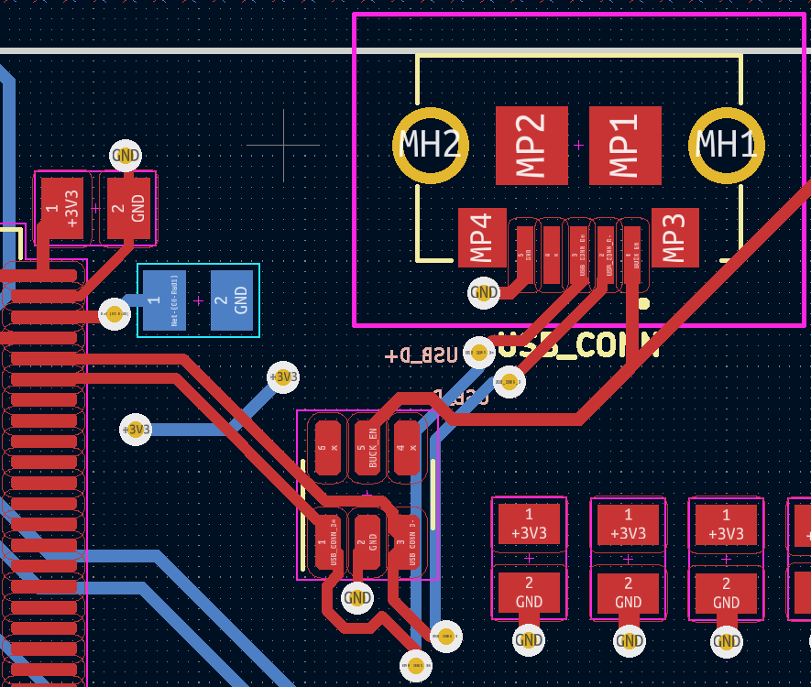
PCB Layout
Main Keyboard USB

Slide 31
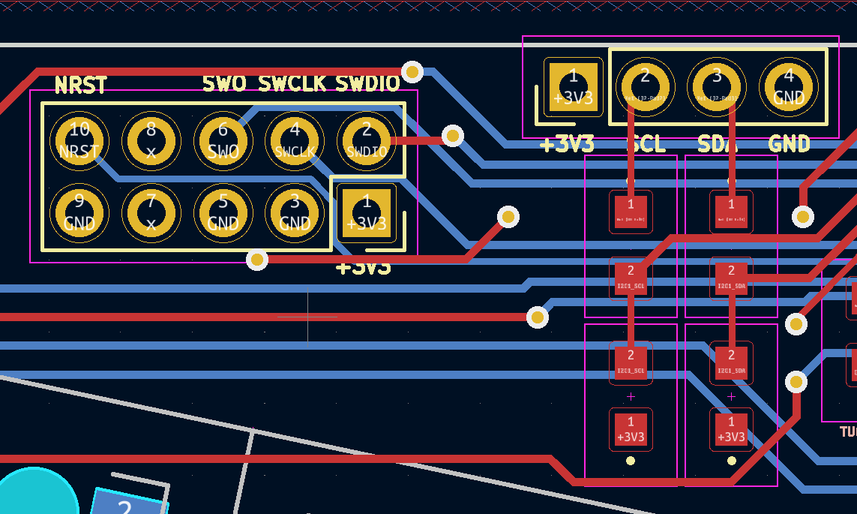
PCB Layout
Main Keyboard Hot PLUG and Debug

Slide 32
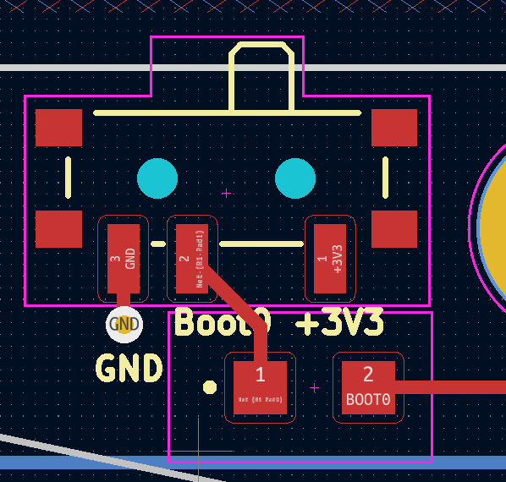
PCB Layout
Main Keyboard BOOT0 Switch

Slide 33
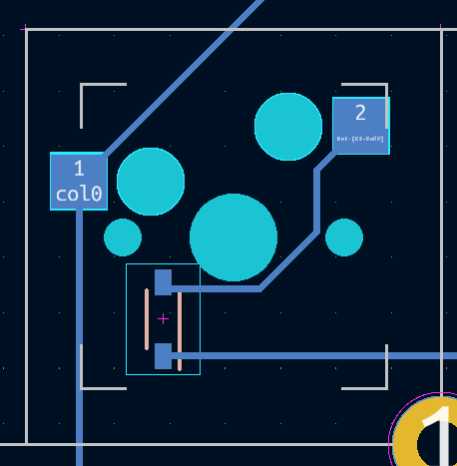
PCB Layout
Main Keyboard KeySwitch

Slide 34
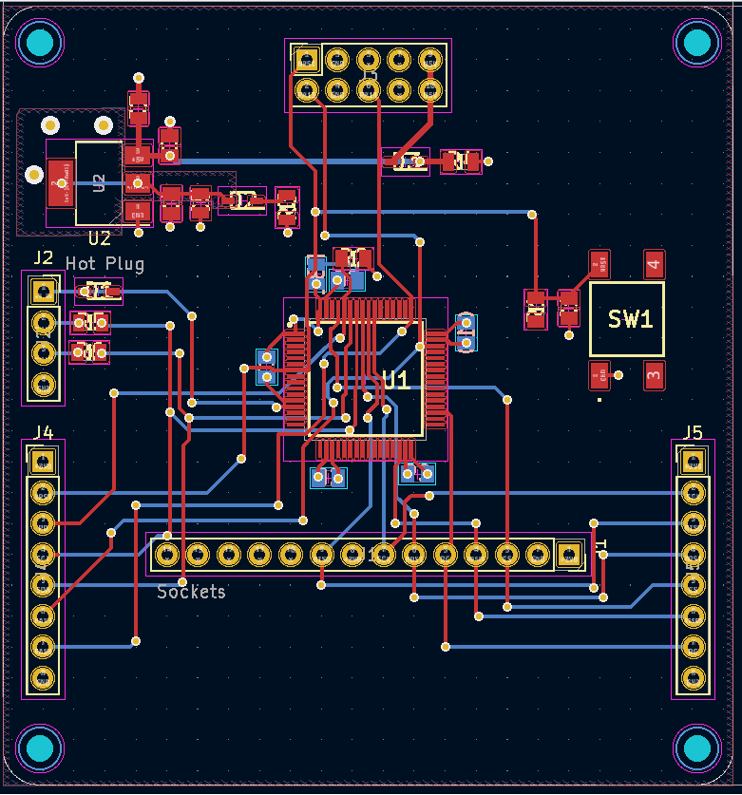
PCB Layout
sub-module Design overview

Slide 35
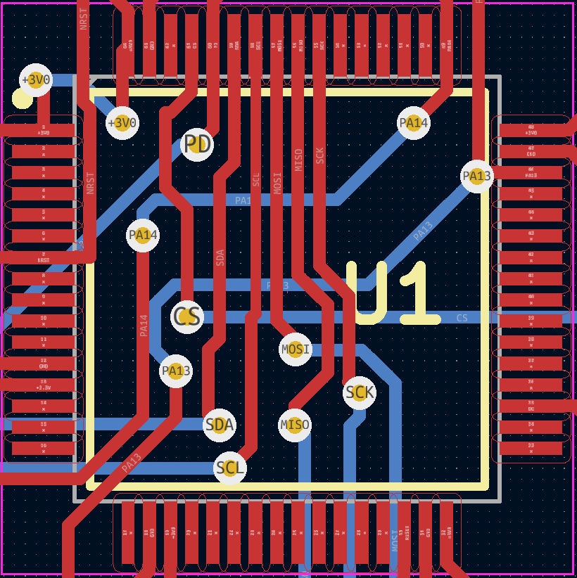
PCB Layout
sub-module Microcontroller

Slide 36
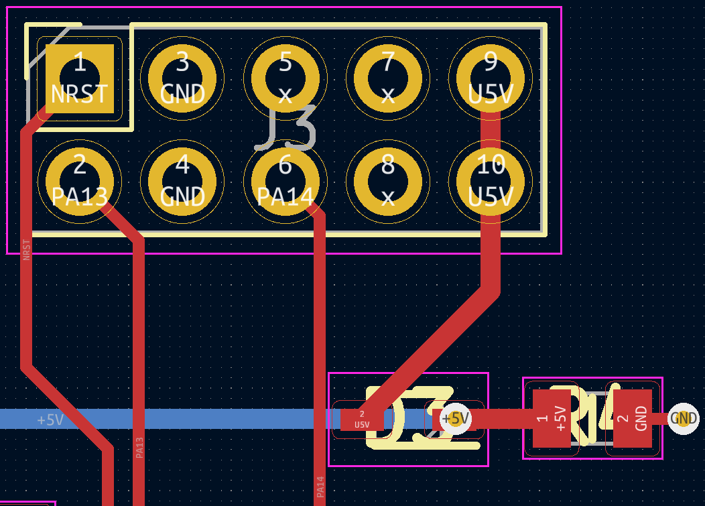
PCB Layout
sub-module Programming Header

Slide 37
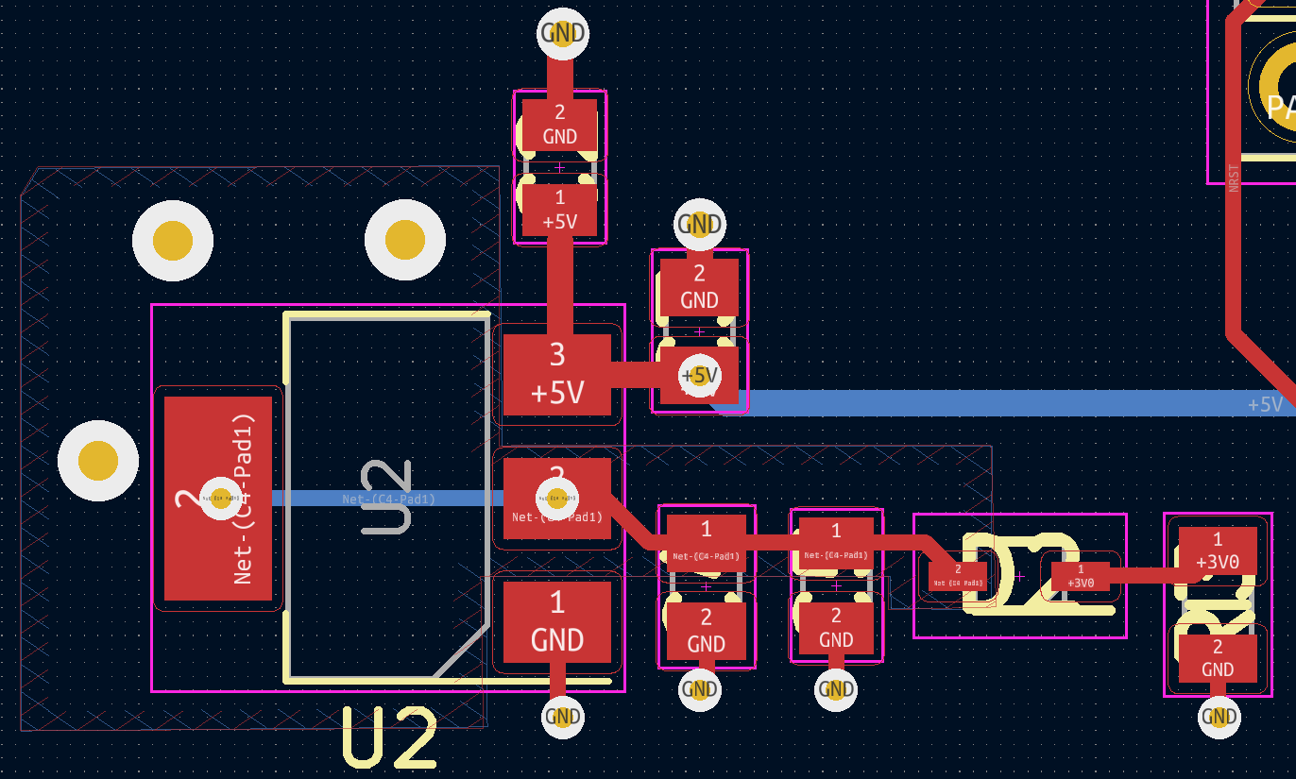
PCB Layout
sub-module Programming Header Decoupling

Slide 38
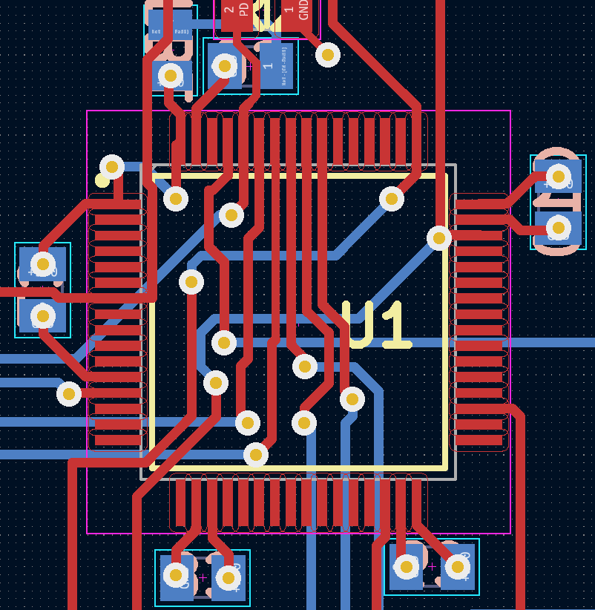
PCB Layout
sub-module Decoupling Capacitors

Slide 39

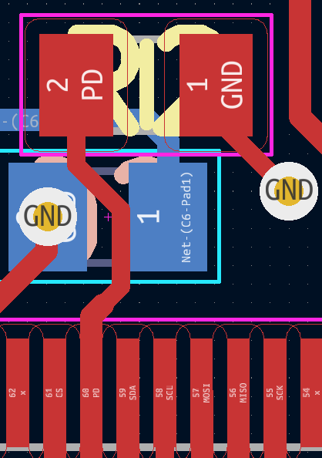
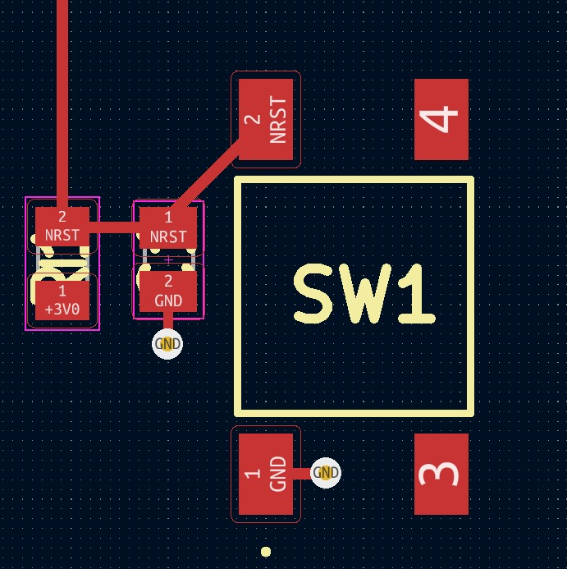
PCB Layout
sub-module Reset and pull down

Slide 40
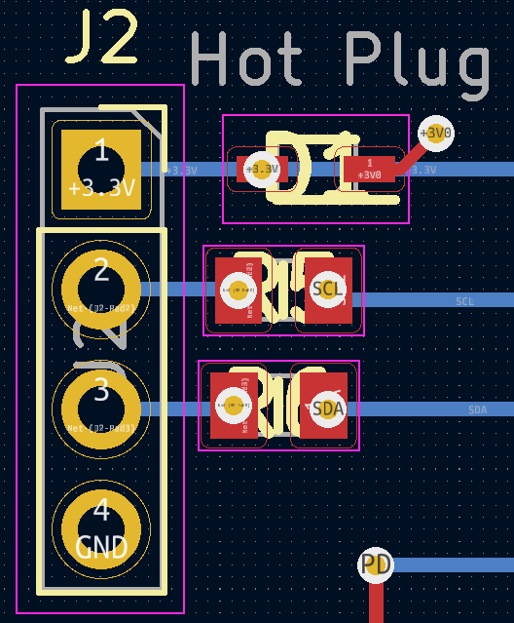
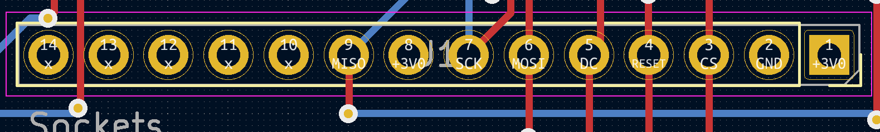
PCB Layout
sub-module Connectors

Slide 41
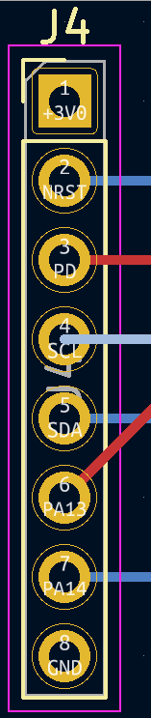
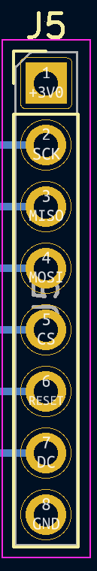
PCB Layout
sub-module Testing Connectors

Slide 42
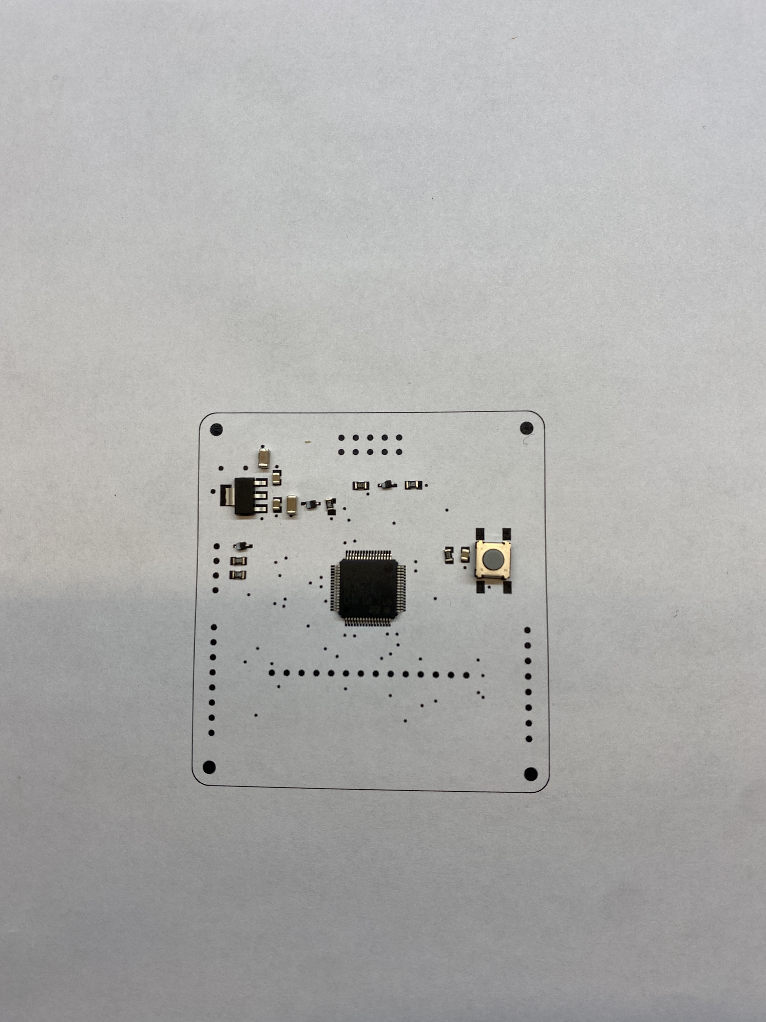
PCB Verification
sub-module Front

Slide 43
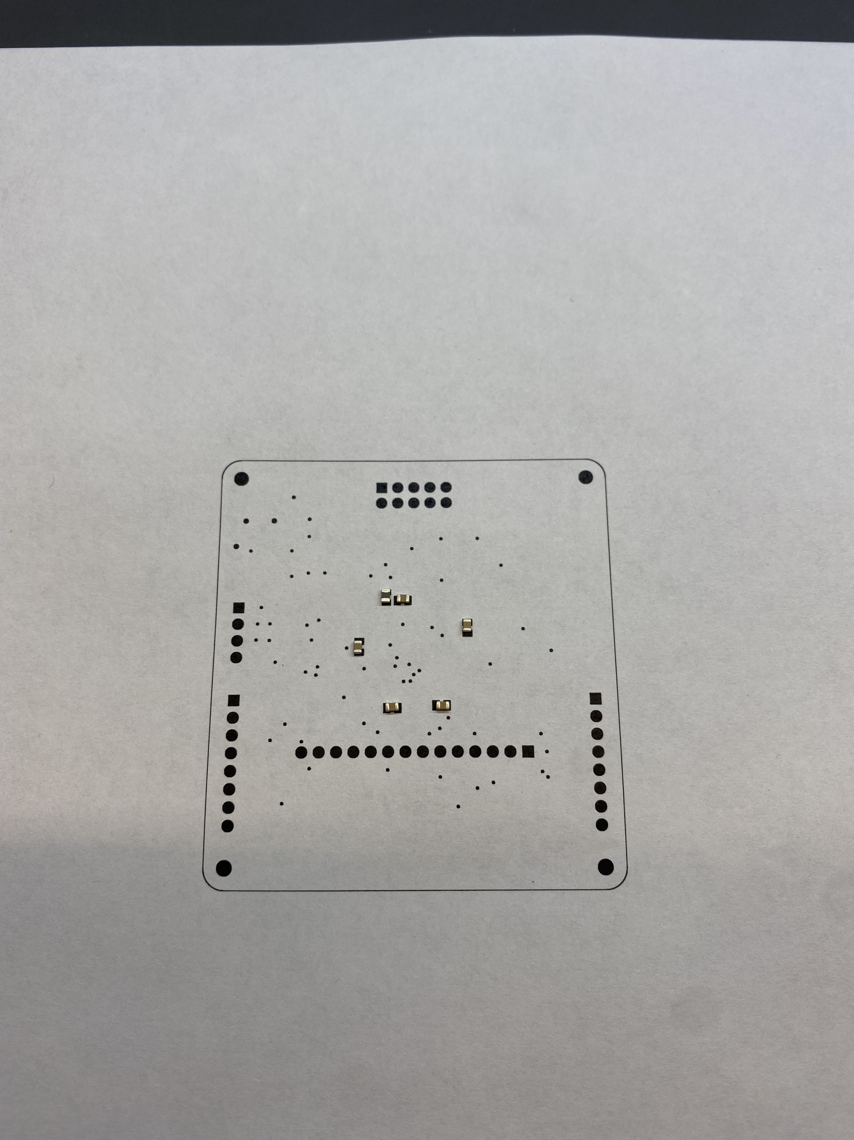
PCB Verification
sub-module Back

Slide 44
Prototyping Progress
Prototyped buck converter made from discrete components
Opted to buy IC buck converter for use in our voltage regulator
Bi-directional communication between micro-controllers tested and proven functional
SPI display tested and proven functional
Key matrix scanning tested, need to verify that scaling to larger key counts
Implementing one possible software method of key debouncing
USB FS controller known to be capable of enumerating as HID
Need to test power draw capabilities

Slide 45
Software Development Status
Common software functionality
Task priority scheduling (In progress)
I2C module communication
Simple single byte bi-directional messages (Completed)
Multi-byte messages (In development)

Slide 46
Software Development Status
Main keyboard Software
Keyboard Scanning (In development)
Have smaller keypad without anti-ghosting diodes for prototyping, need to scale up to full key matrix upon PCB assembly
Key debouncing (In development)
Have one method, need to test with larger keyboard to verify performance.
HID enumeration as keyboard input device (Not yet started)
USB controller known to be functional based on part manufacturer demo code for HID mouse enumeration.

Slide 47
Software Development Status
sub-module Module Software
SPI display
Minimally viable functionality complete
Utilization and integration with remainder of system in development

Slide 48
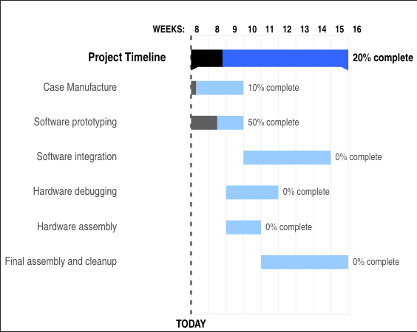
Project Timeline

Slide 49
3D Printing
Questions?

